Slide 1
Live Virtual Class
NLP & Text Pre-processing
Aniket Chhabra

Slide 2
Agenda
What is NLP & Background
Text Preprocessing
Lab Exercise

Slide 3
NLP & Text Mining

Slide 4
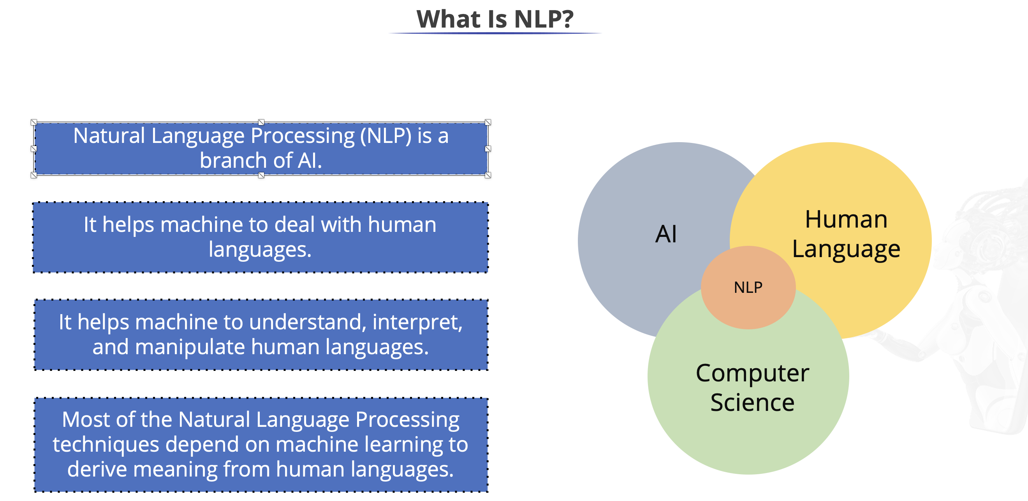

Slide 5
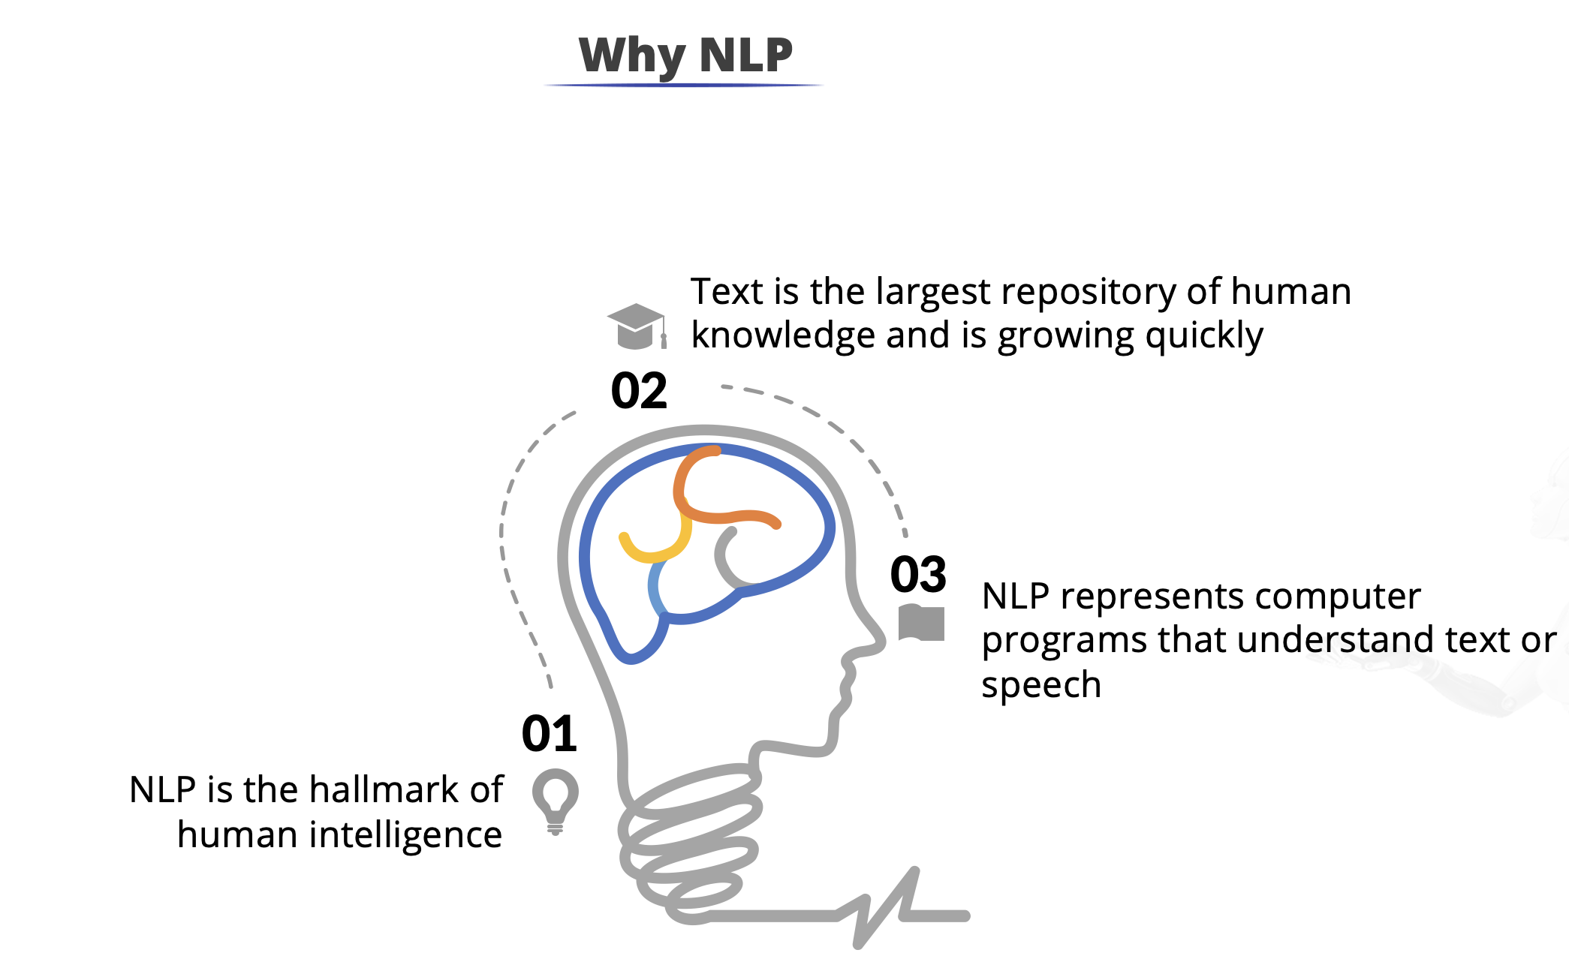

Slide 6
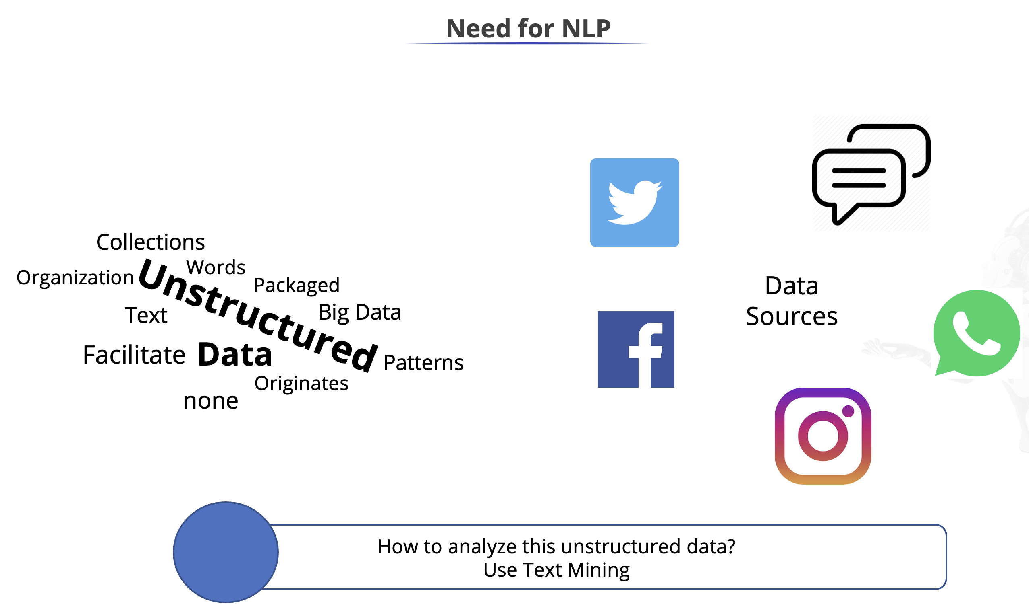

Slide 7
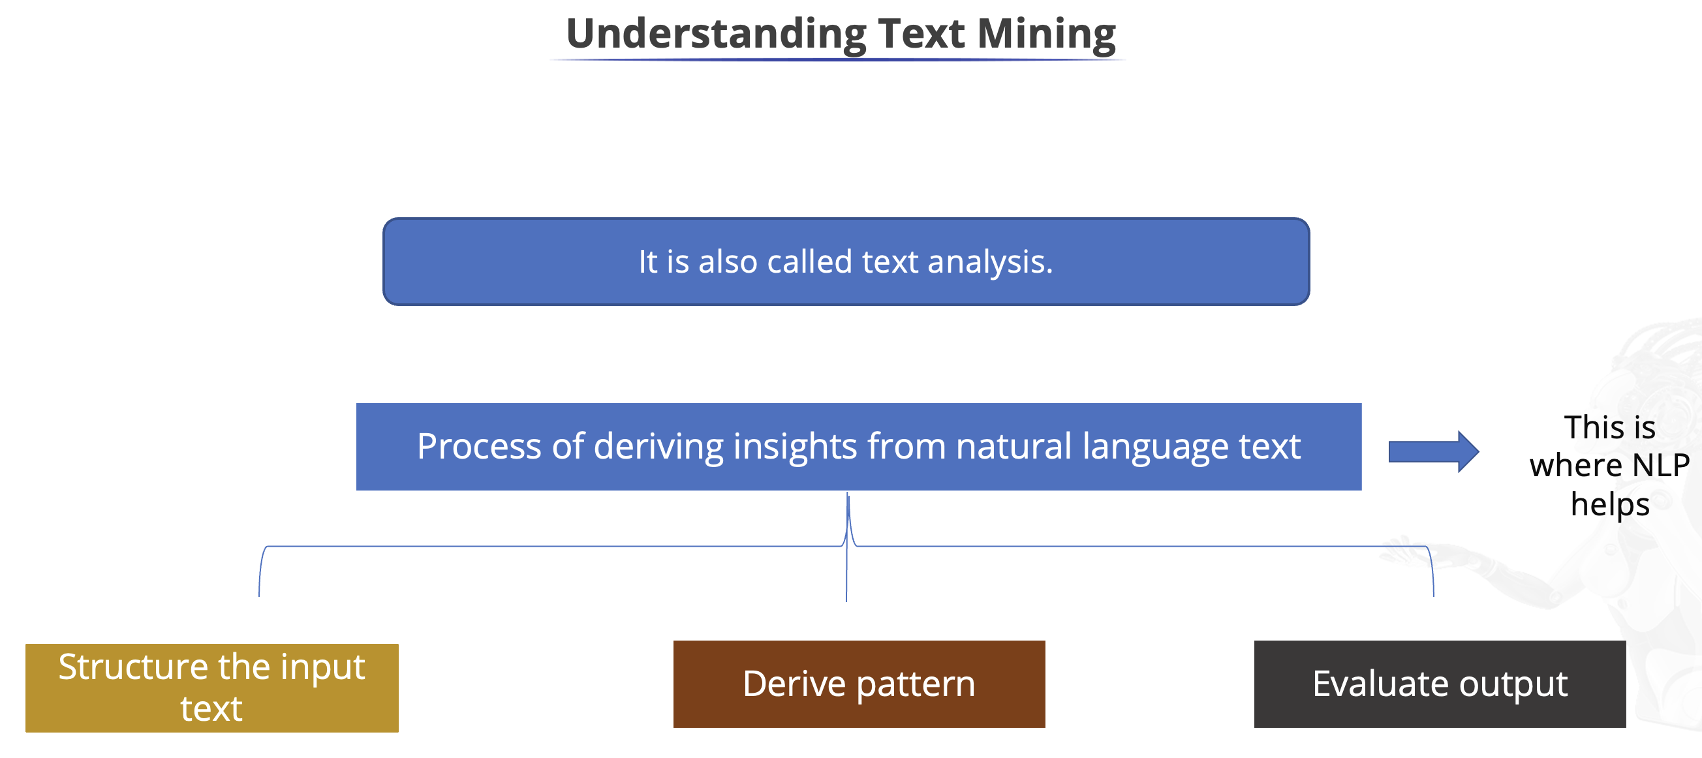

Slide 8
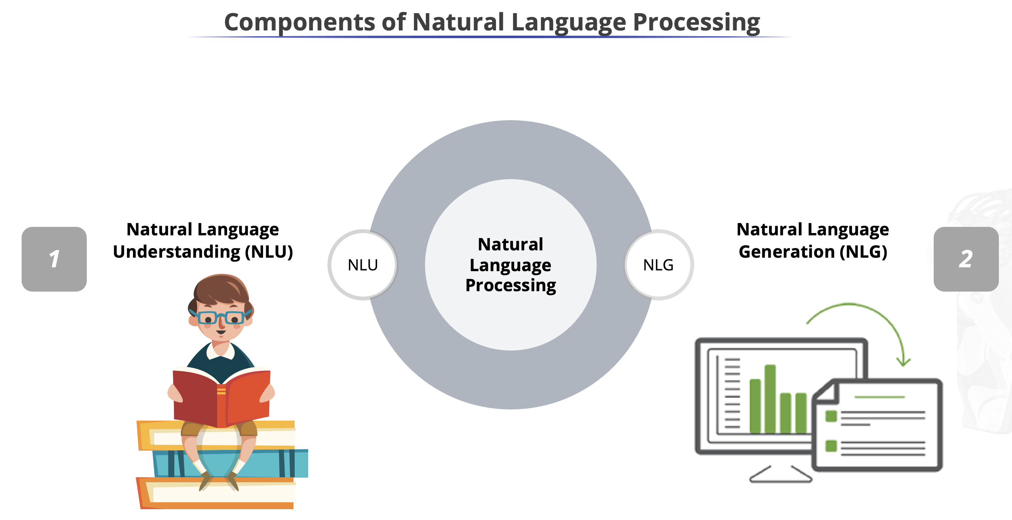
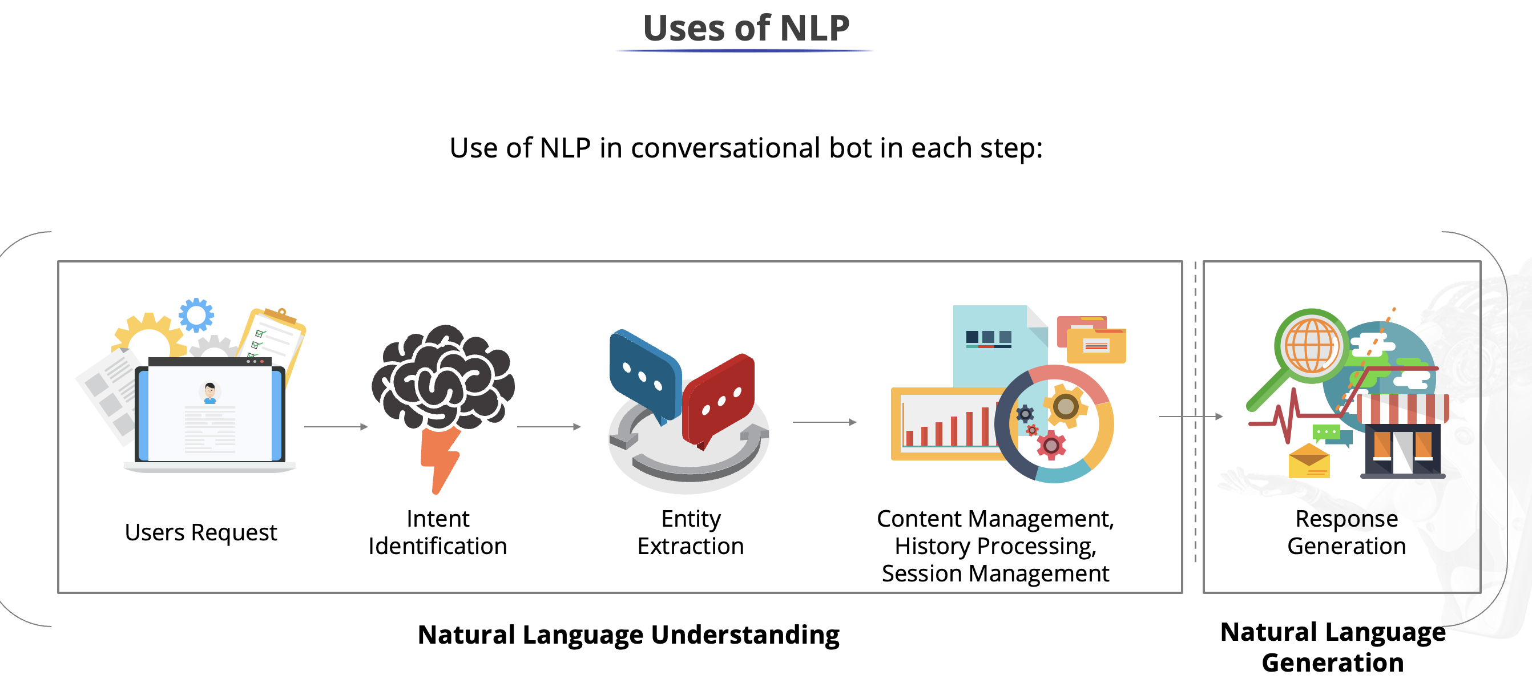

Slide 9




NLP Components Details
NLU
Lexical Processing
Vector representation of text data - Text cleaning, Regex, Tokenization
Libraries - NLTK, SpaCy, Gensim -
Models - frequency based analysis - wordcloud, frequency plot,
Feature Extraction - BOW, TF-IDF, Topic Modelling (basics - LDA/LSA)
Syntactical Processing
Syntax of the text - Generation of text, POS, Parsing - constituent and dependency parsing, chunking, word sense disambiguation
Libraries - NLTK, SpaCy, Textblob, Gensim
Models - NER -iOB, CRF
Sematic/Contextual Processing/Analysis
Underlying relationship between the words/sentences - Word Embeddings, Feature Extraction
Libraries - Gensim, KERAS/TF
Models - Word2Vec models, GloVe, BERT
Machine Learning Models
Supervised Learning - Text classification - ham/spam, POS tagging, Sentiment Classification
Unsupervised Learning - Topic Modelling - LDA/LSA/pLSA/NMF/PCA
Deep Learning Models - (Day - 5&6)
Supervised Learning - ANNs, Sentiment Classification - Word2Vec/RNNs/LSTMs, Seq2Seq (Encoder - Decoder Models
NLG
Language Models - RNNs/LSTMs/GRUs

Slide 10
Text Preprocessing

Slide 11
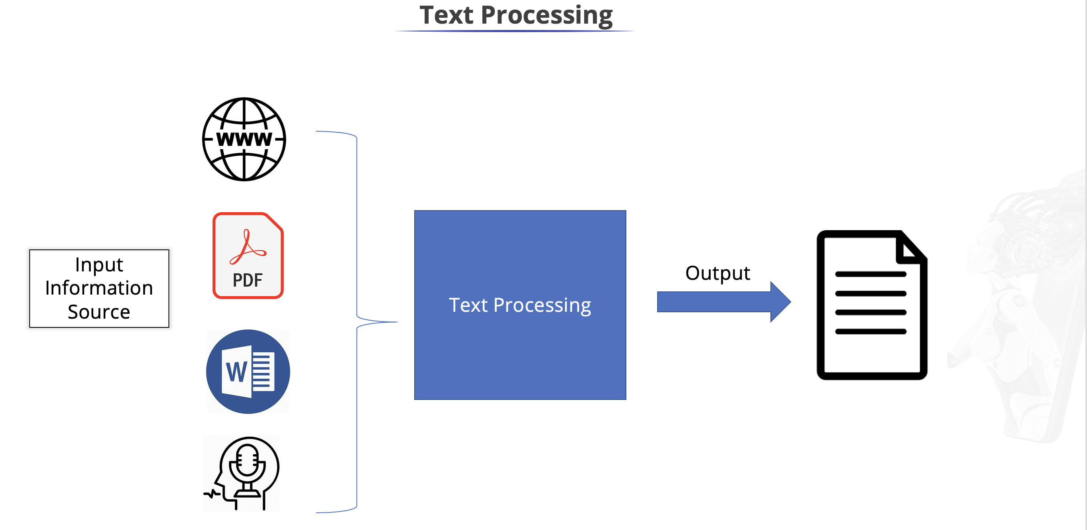


Slide 12
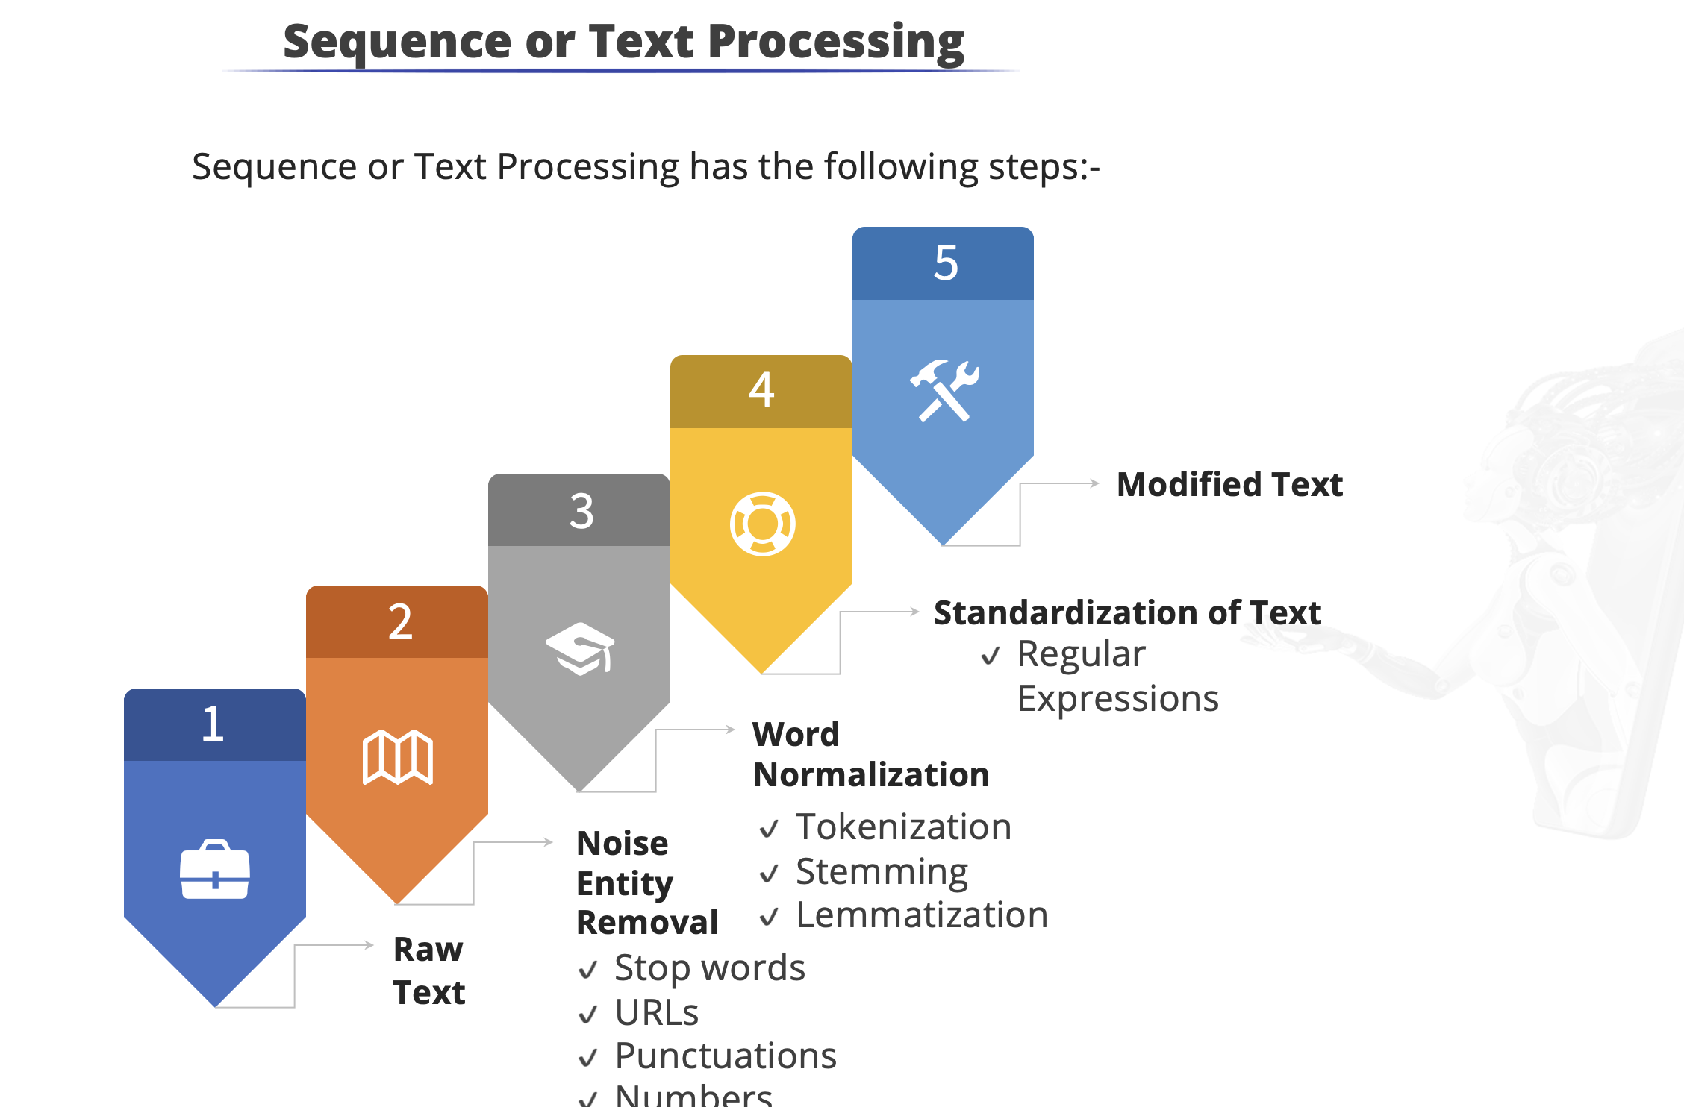


Slide 13
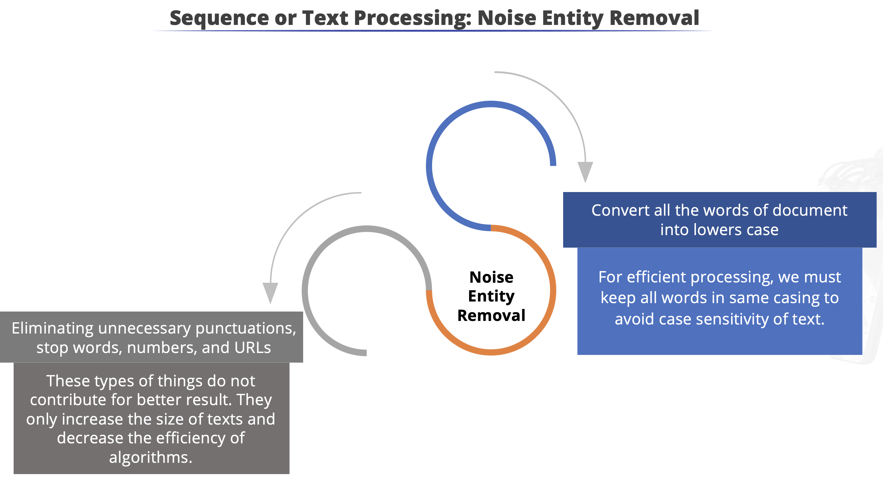






Slide 14
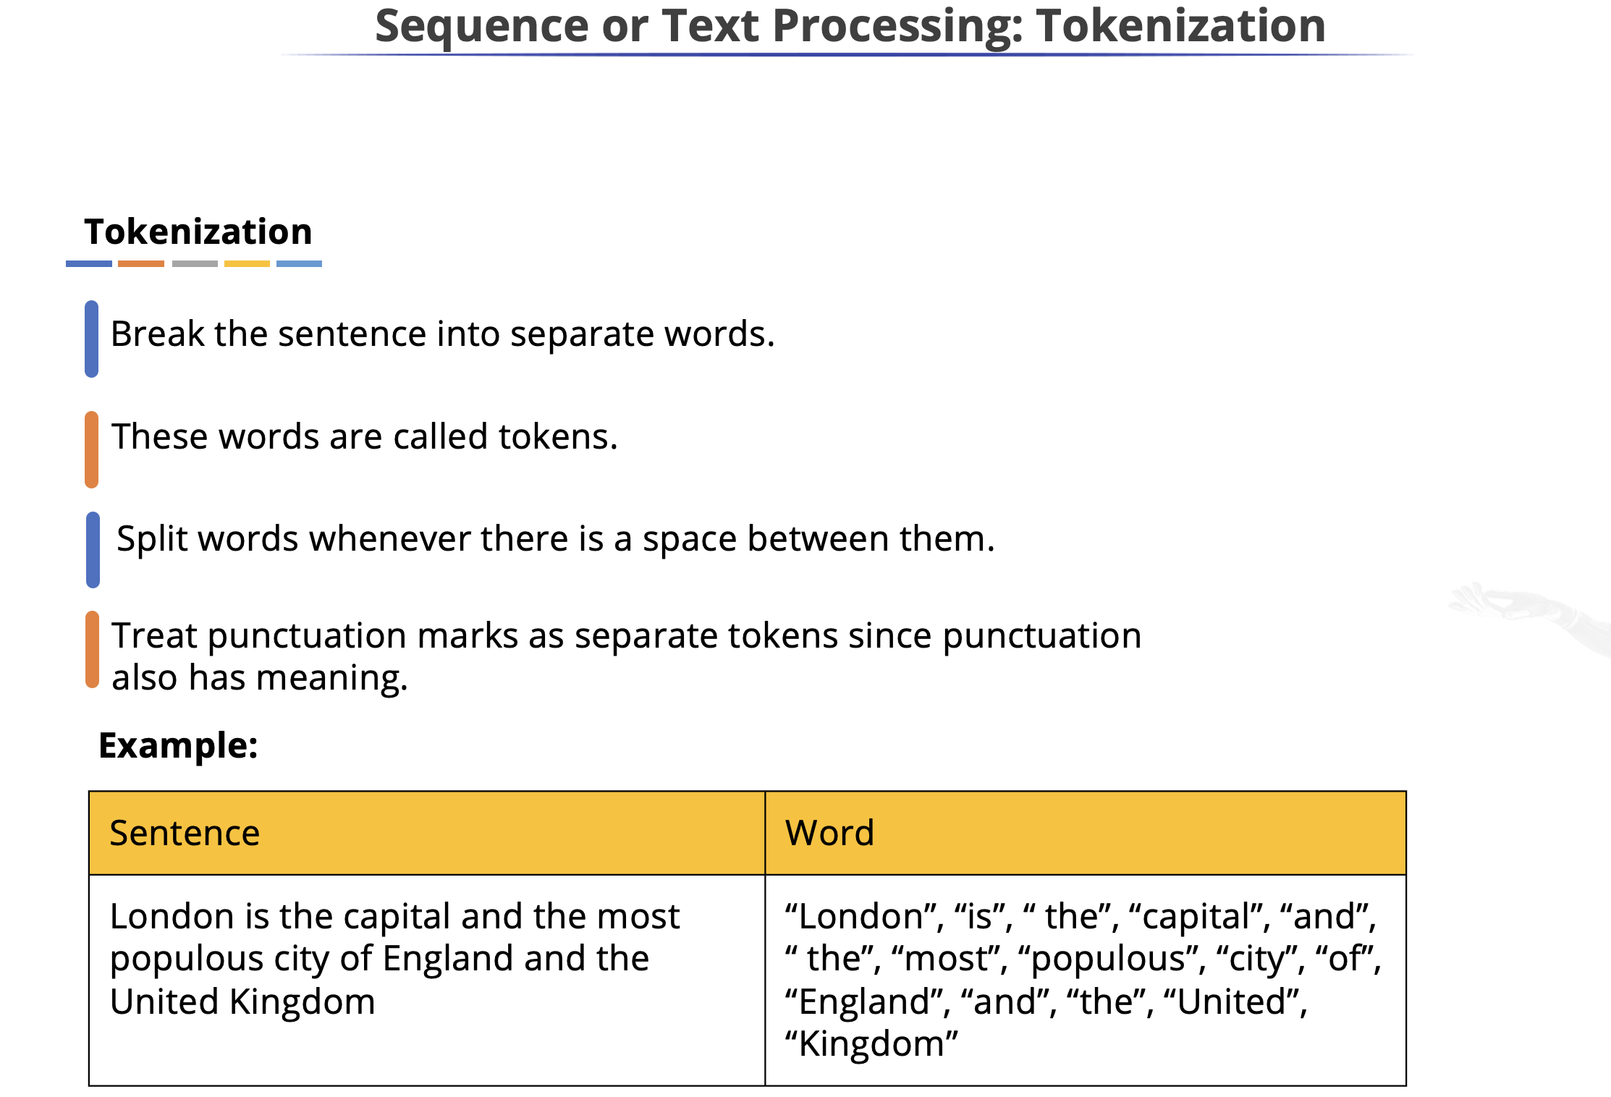




Slide 15
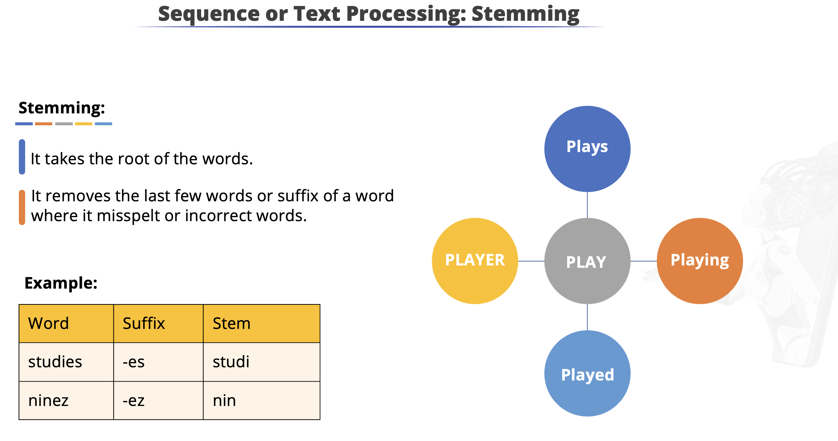
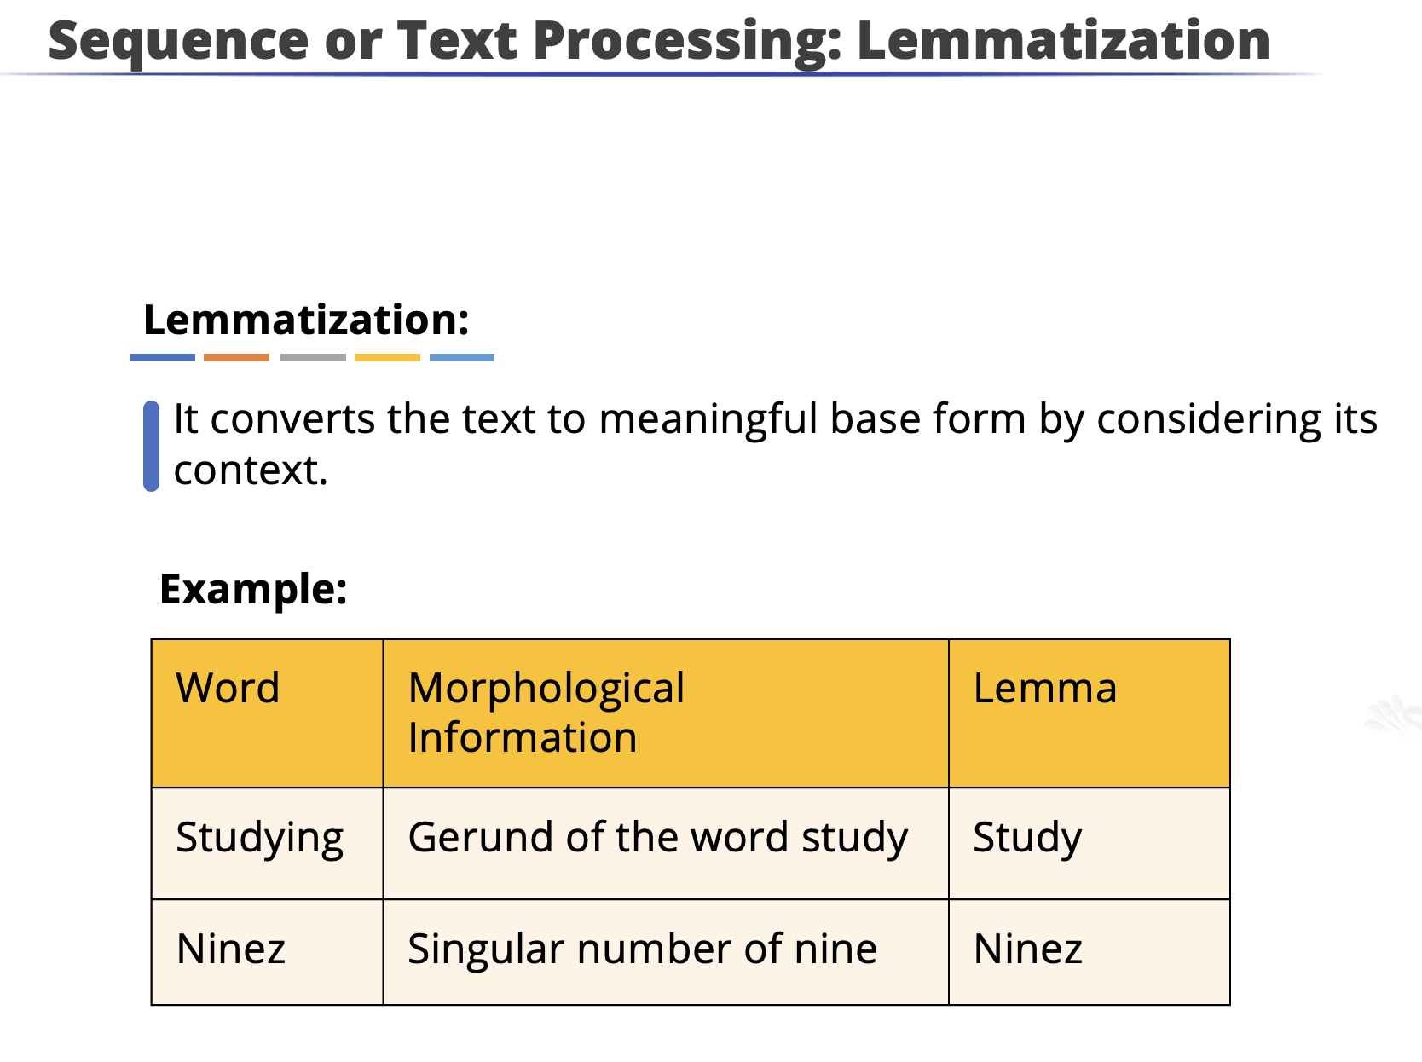


Slide 16
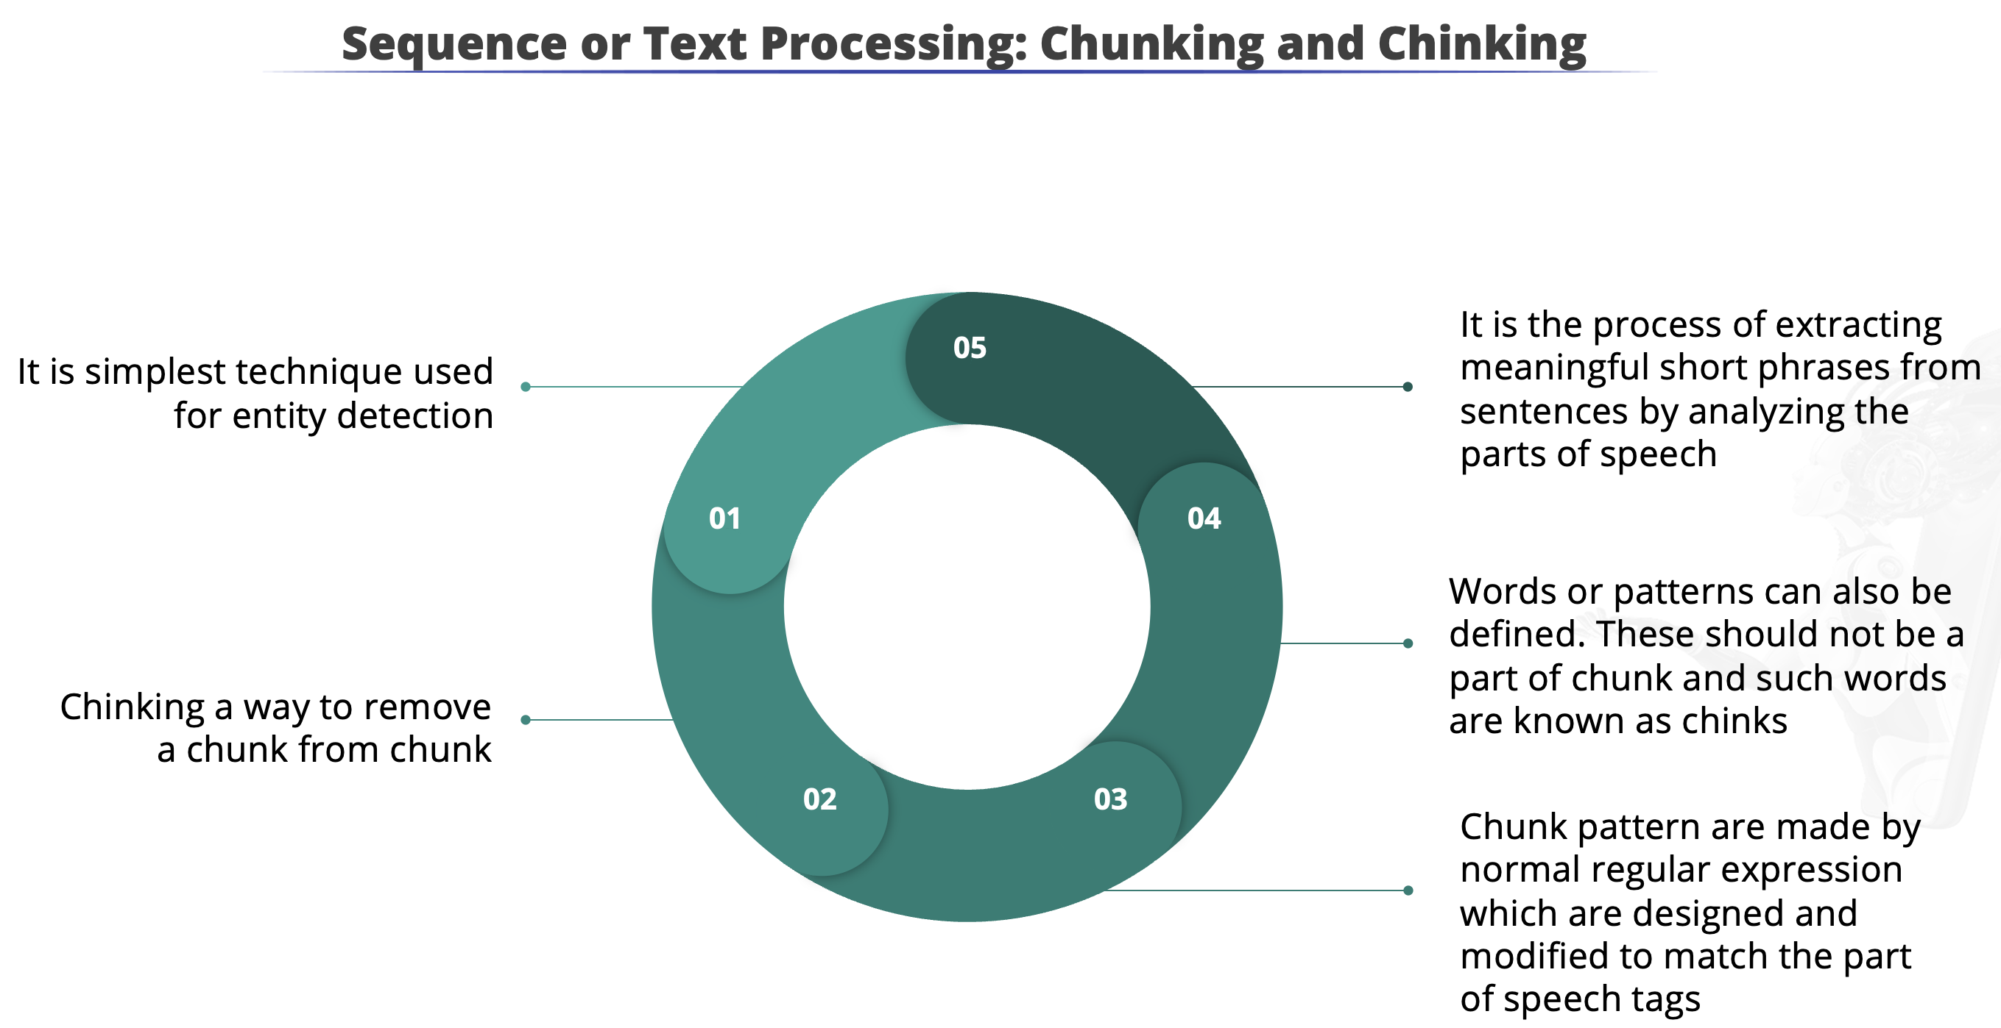
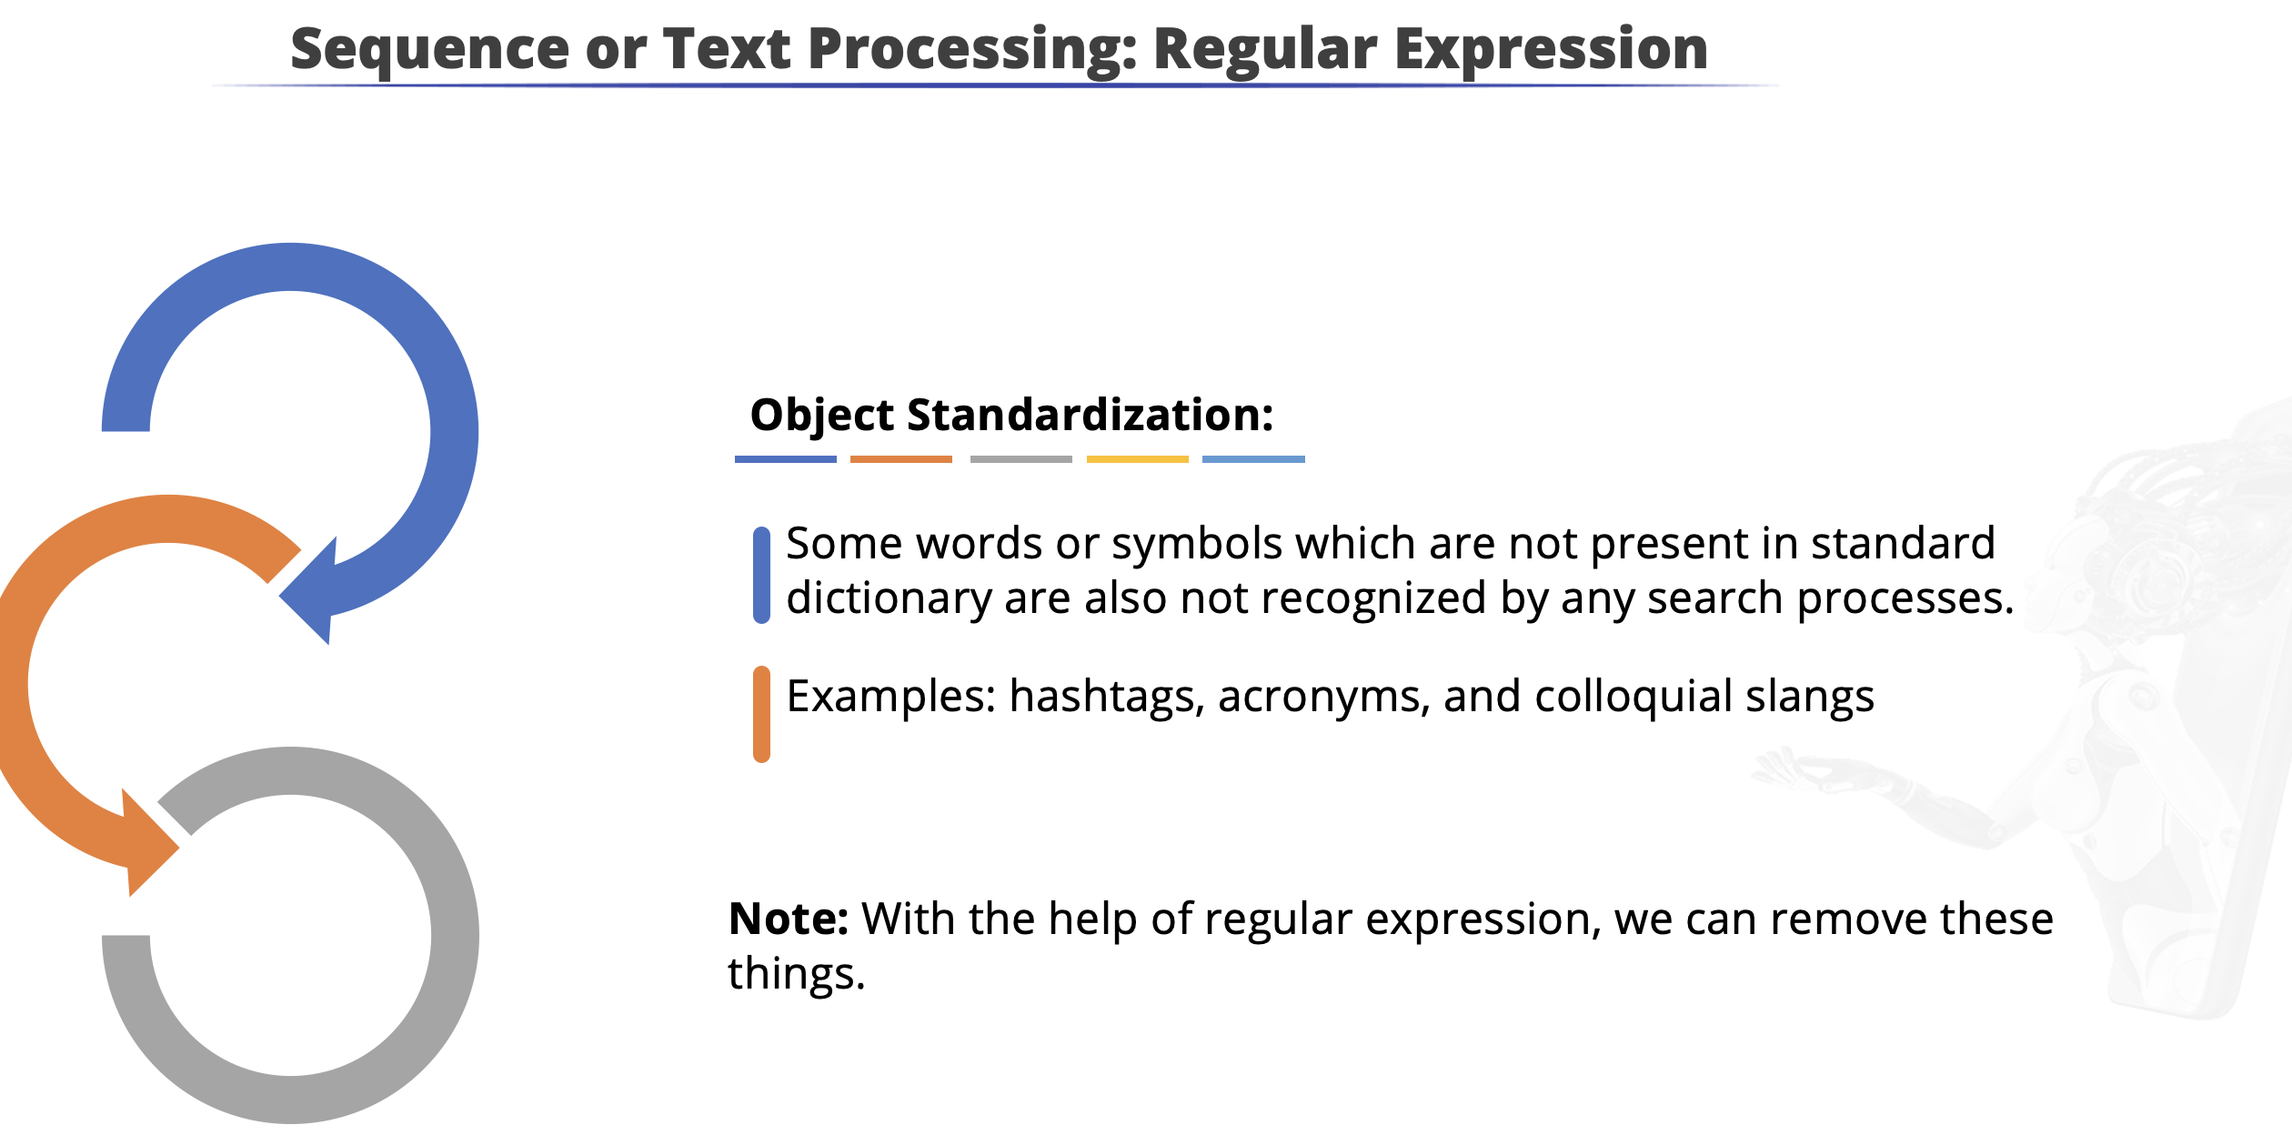

Slide 17
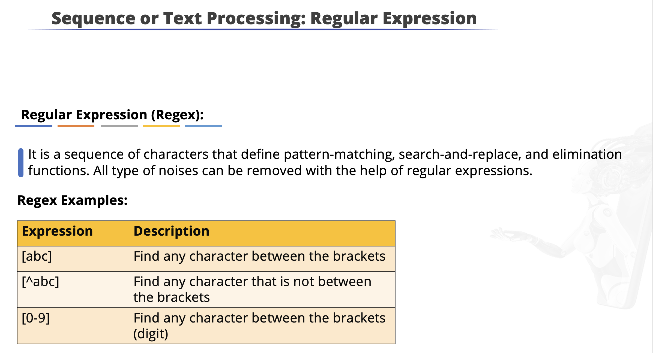

Slide 18
Python Notebooks
NLP Libraries
https://colab.research.google.com/drive/1thDIqQgz_YADYv1BikHa2xBC4WzWVqlW
NLP Libraries

Slide 19
Any doubts?

Slide 20
Summary
Point 1
Point 2
Point 3
DO NOT WRITE ANYTHING
HERE. LEAVE THIS SPACE FOR
WEBCAM

